Slide 1
Prairie Line Trail at UWT Station Project Options Presented to Tacoma Arts Commission by Milt Tremblay Director of Facilities and Campus Services February 13th, 2012

Slide 22
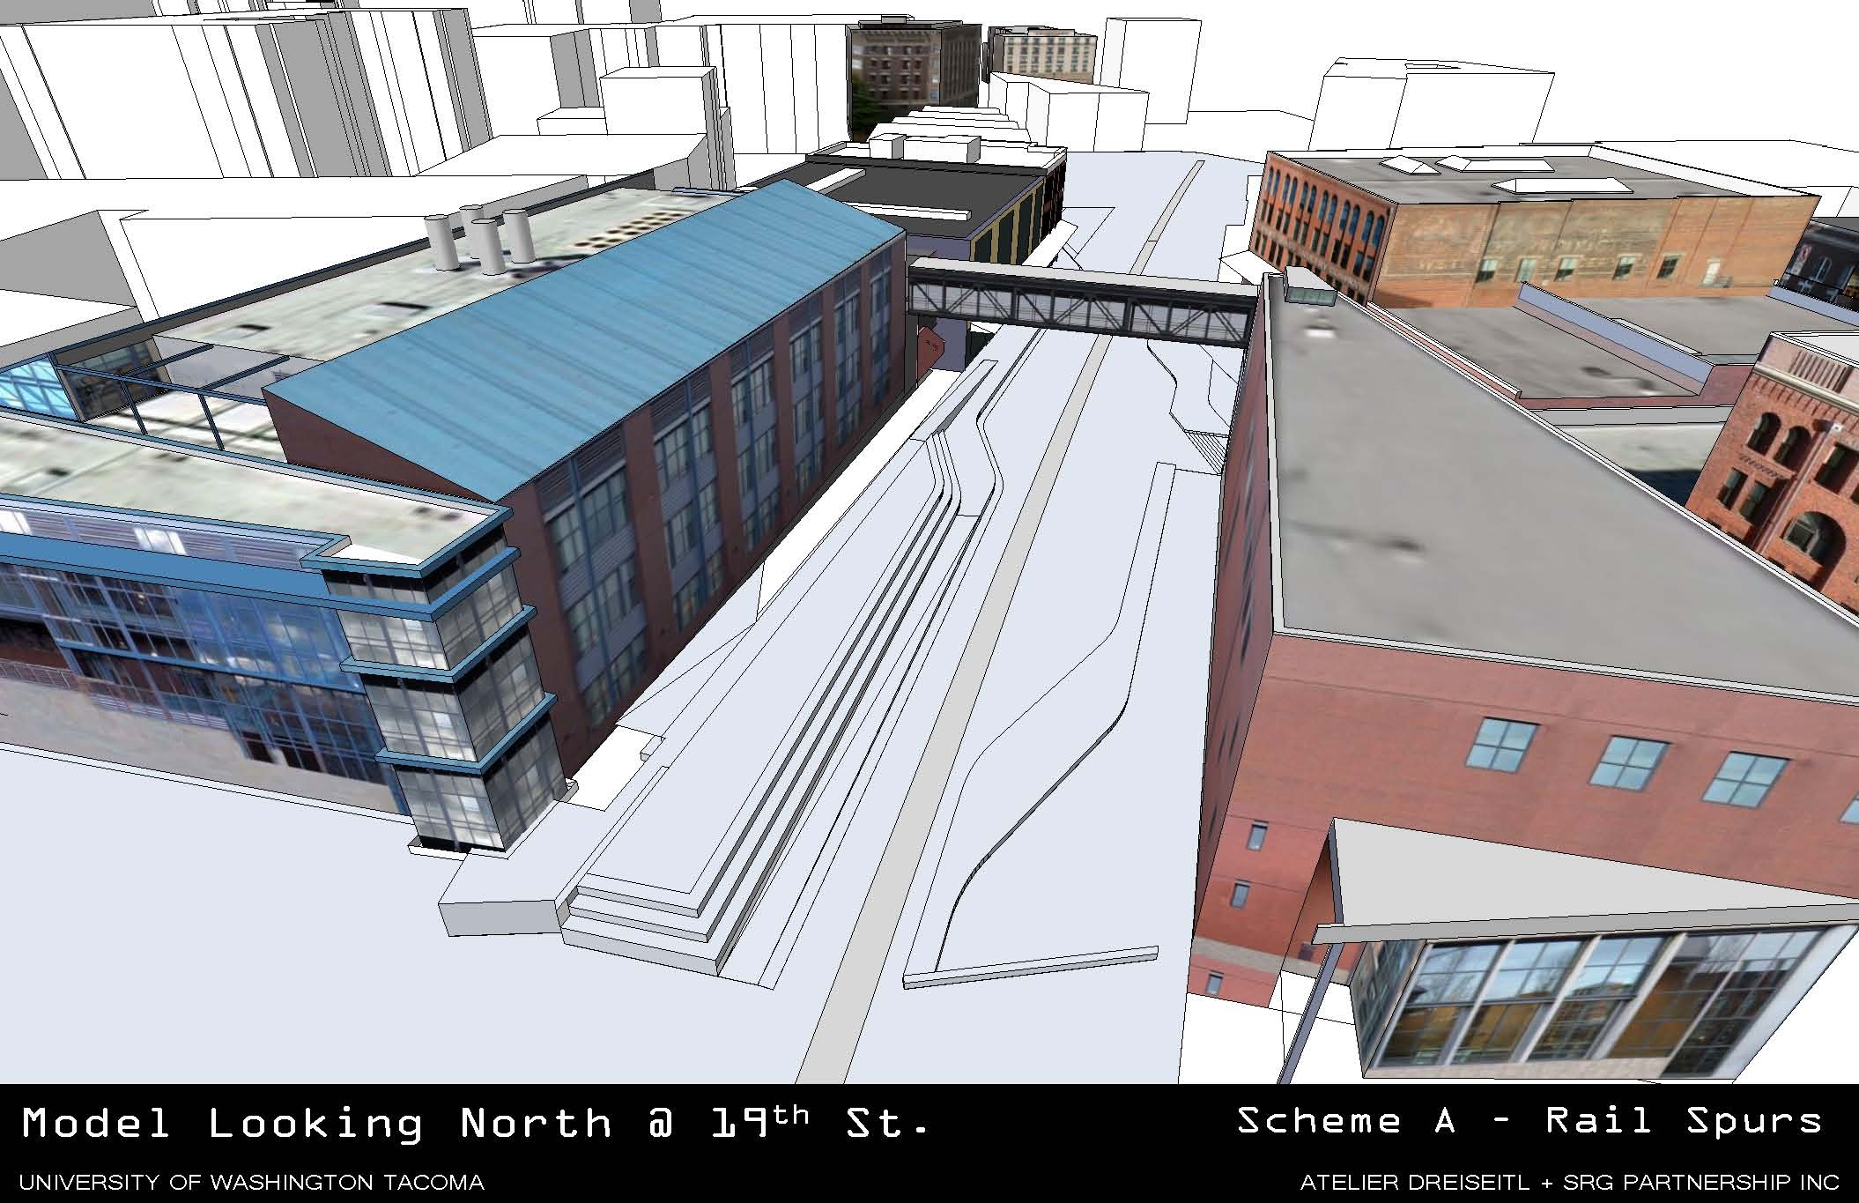

Slide 24
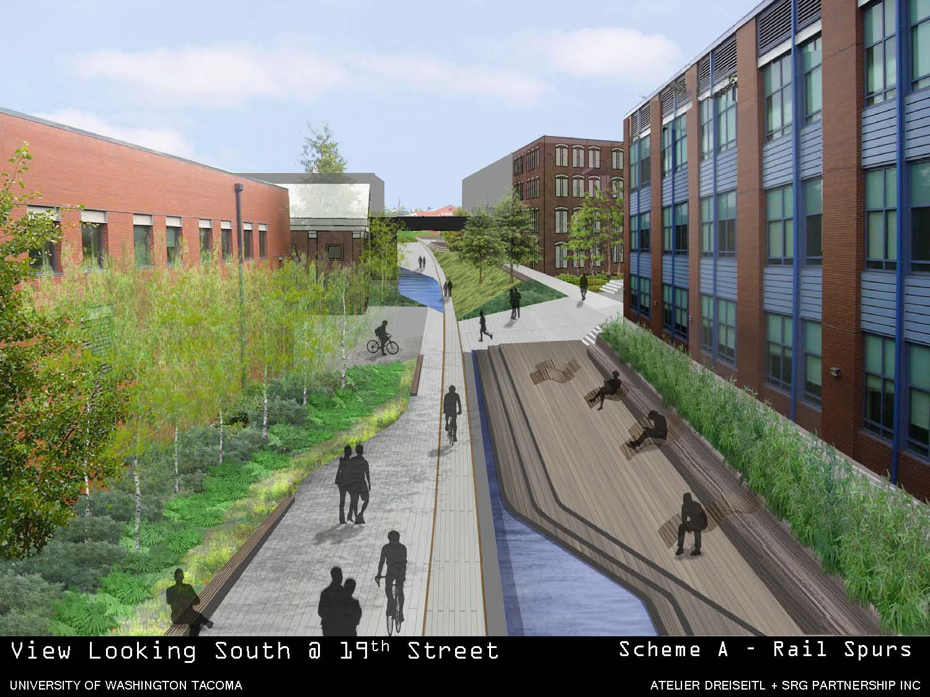

Slide 33
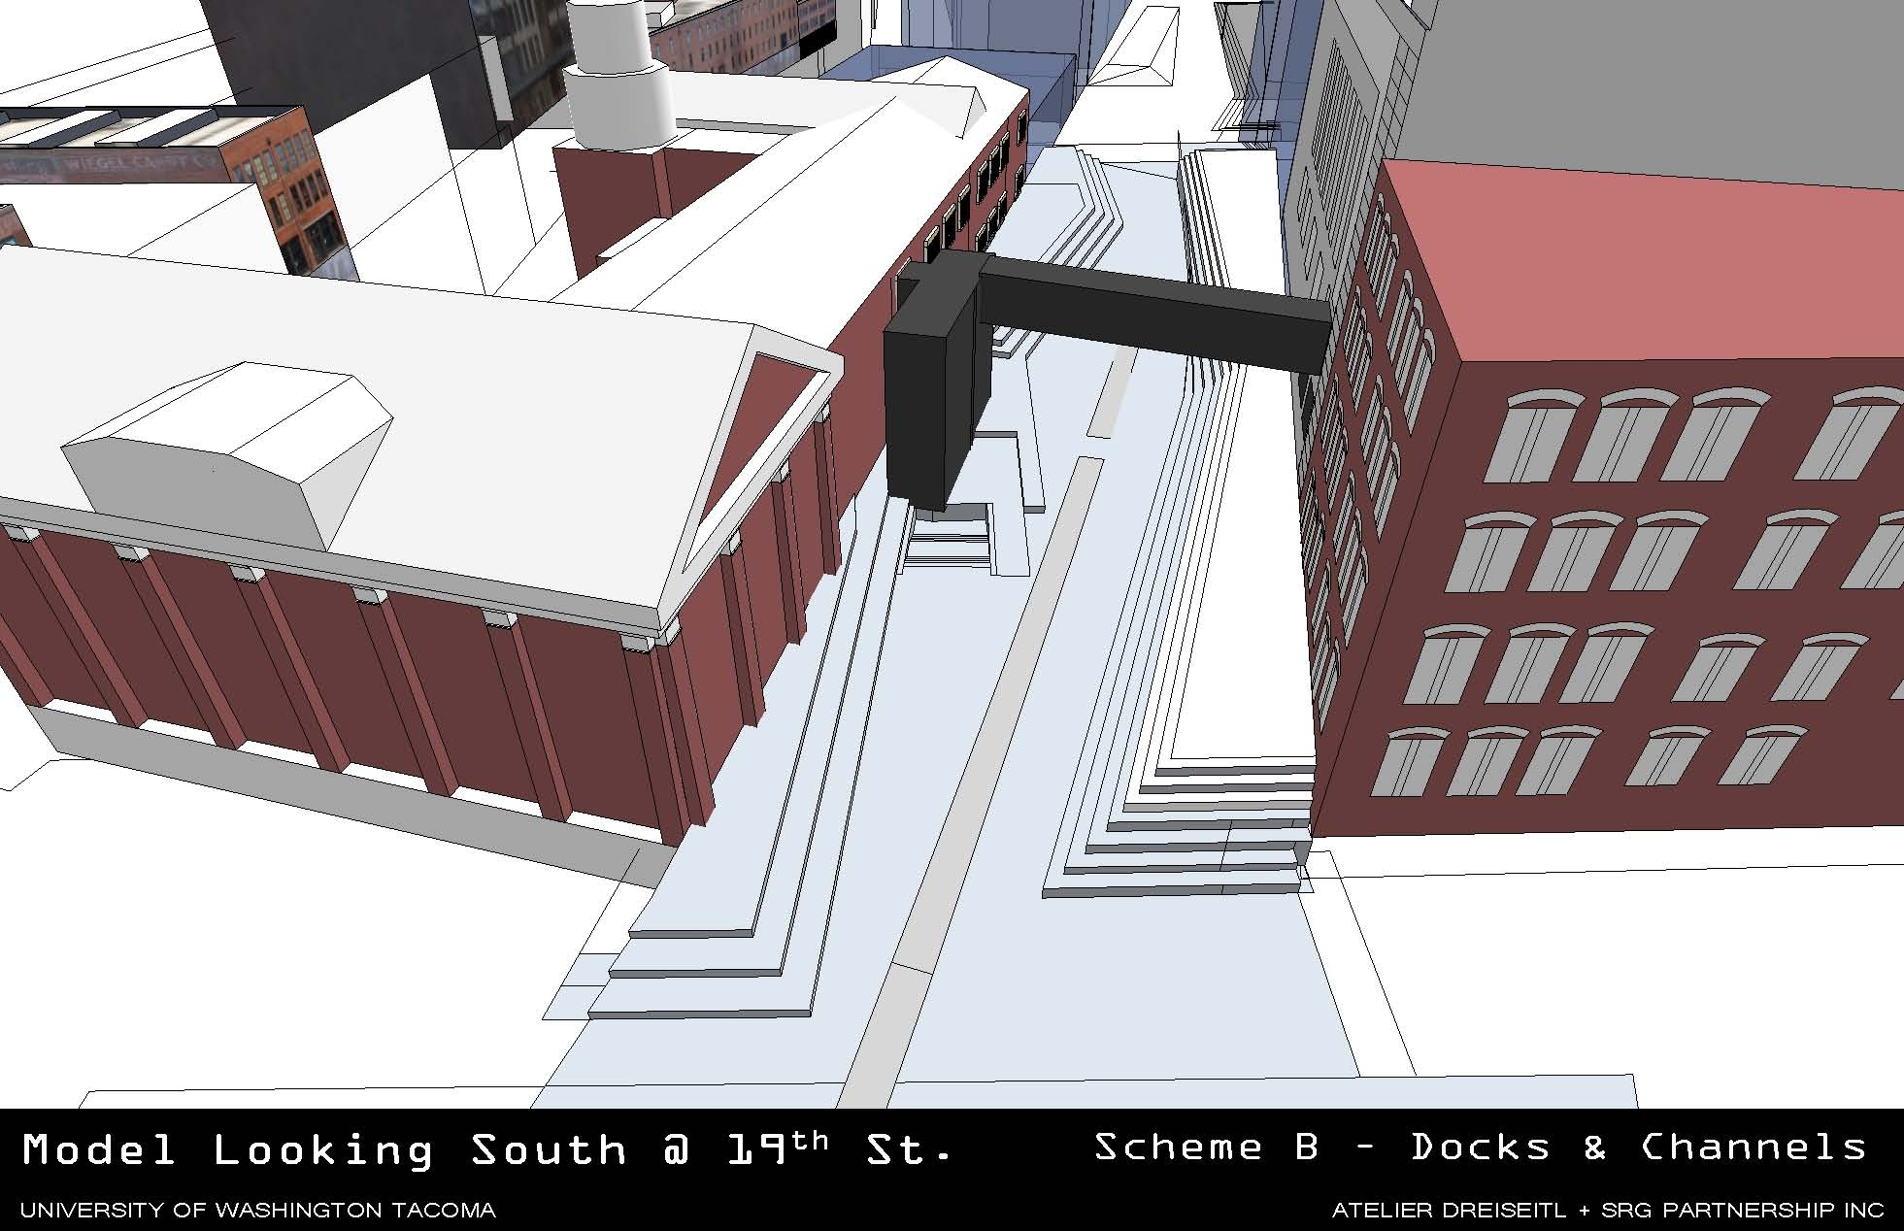

Slide 35
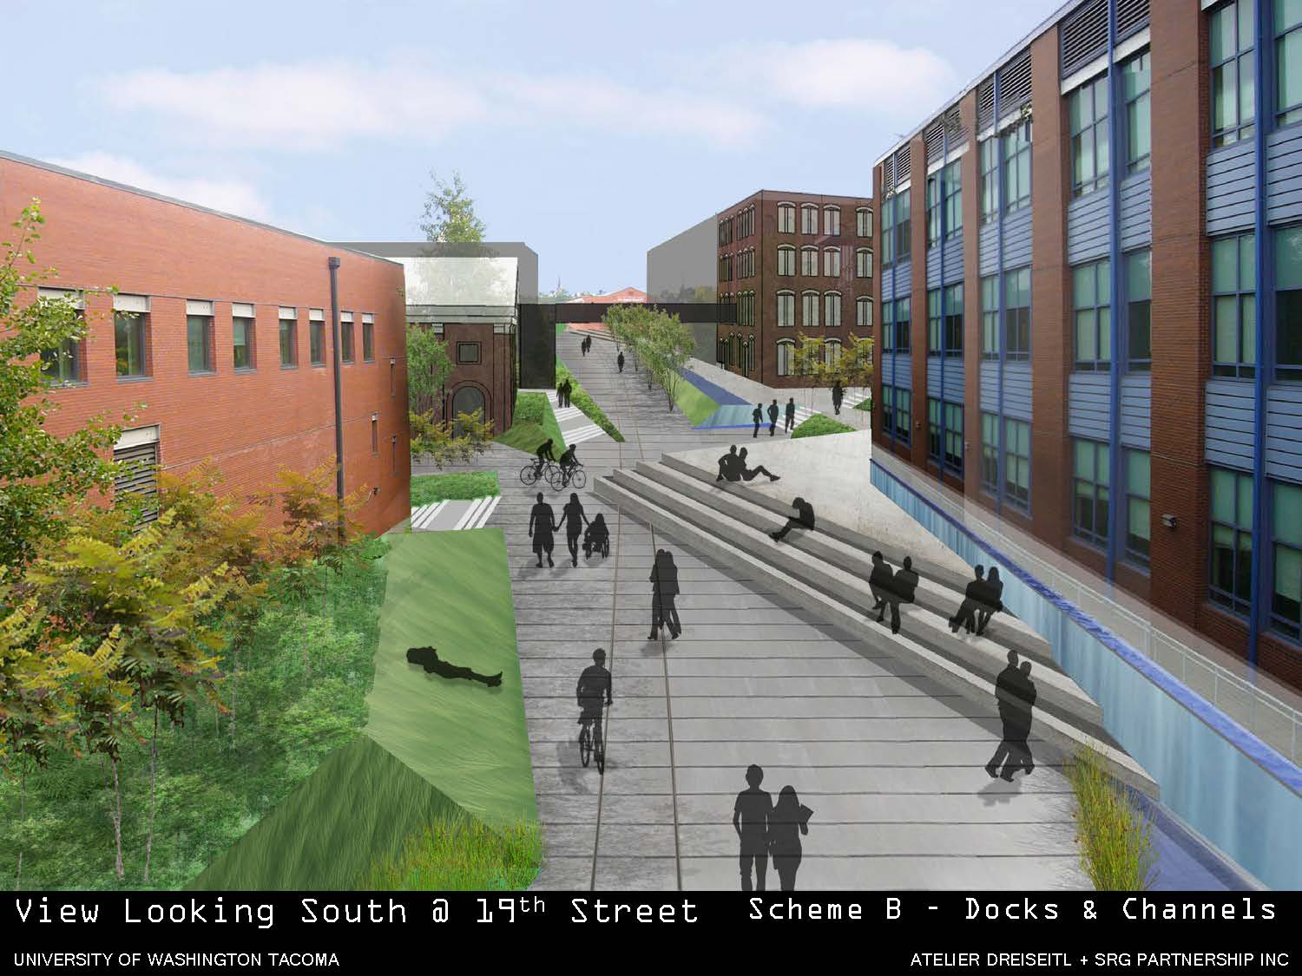

Slide 38
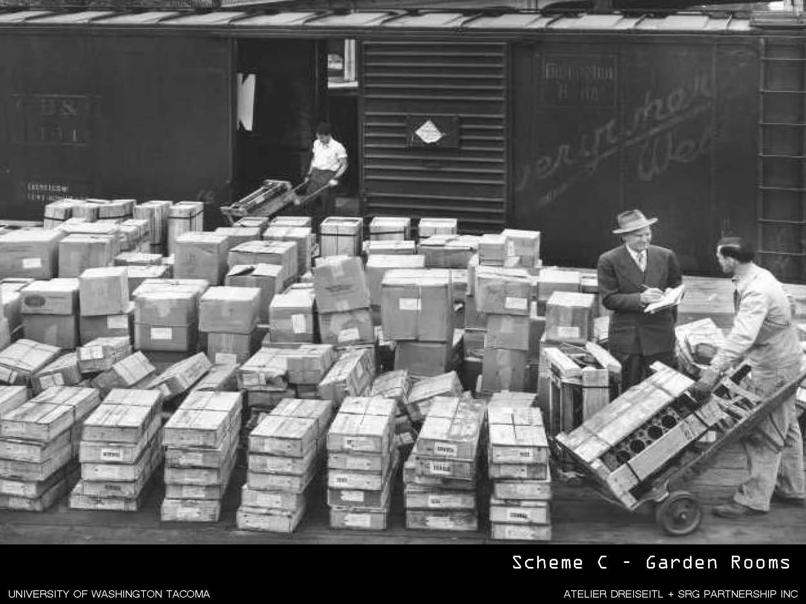

Slide 44
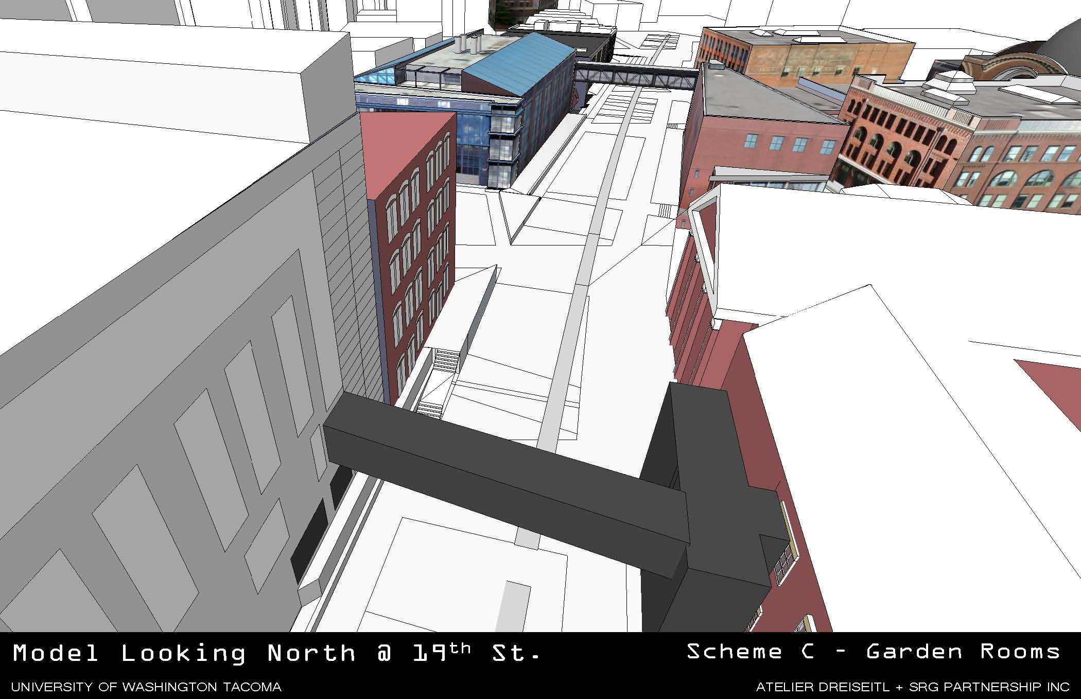

Slide 46
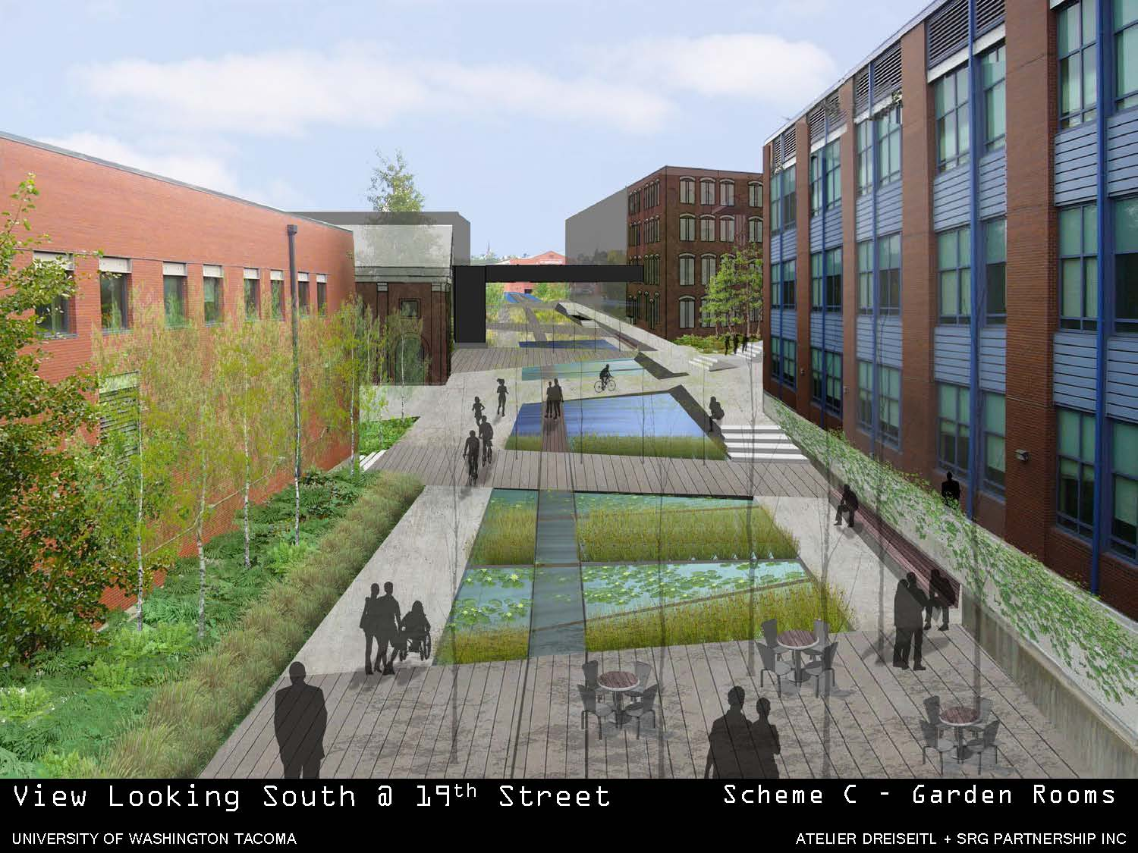

Slide 51
Thank You! Questions? Comments? milt@uw.edu

